Slide 1
Knowledge Sharing VISION IP - VIPDRV
Oct, 2022
Rev. 1.00 by Nguyen Huu Anh

Slide 2
AGENDA
OVERVIEW
SW ARCHITECTURE
SW COMPONENTS
SW COMPONENT APIs
R-CAR 4th GENERATION
SW WORKFLOW

Slide 3
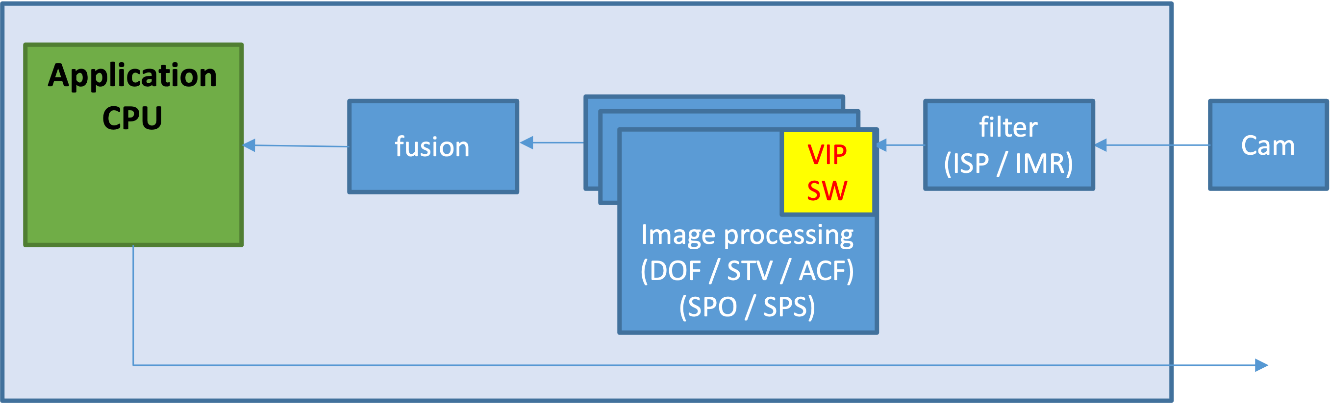
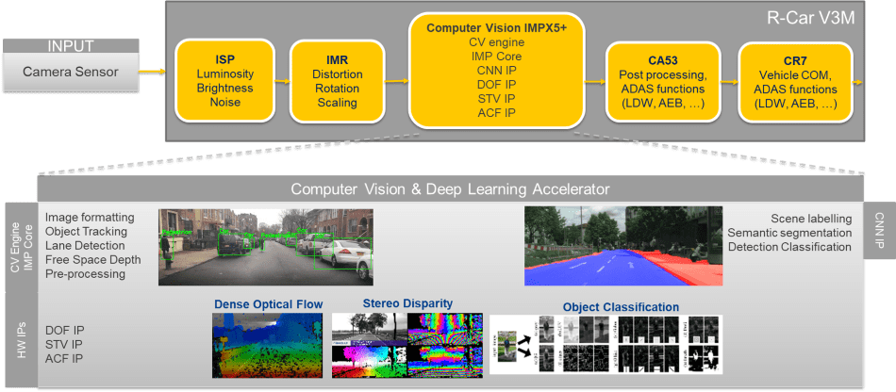
1. OVERVIEW
■ Image Processing Pipeline

Slide 4
2. SW ARCHITECTURE
■ Modules
5 types of VisionIPs supported by HW: ACF^{v3x only}, DOF^{all}, STV^{v3x only}, SMD-POST^{v4h only}, SMD-PS^{v4x only}
■ SW components
2 types of SW components:
Configuration Library - one per HW IP
System Driver - one common across all IPs (until xOS2 this was separate per HW IP)
■ Components Function
SW components function:
Configuration Library: prepares a configuration object (cfg, register values to be written to HW later)
System Driver: push the cfg. values to HW & triggers HW processing (via DMA), monitor the processing done/error HW events (via interrupt)
For details:VIPRSWP Software Architecture Specification

Slide 5
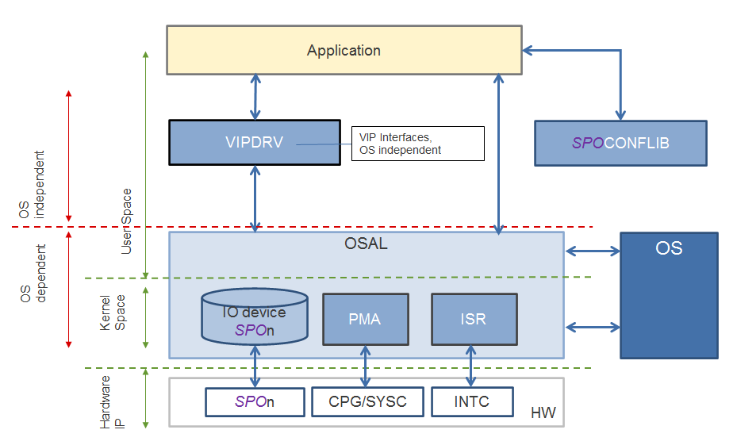
3. SW COMPONENTS
■ Application SW
User application to access all provided VIP functions
■ Config Library
Create config obj containing register values
Only interface to Application
■ System Driver
Enabling/disabling and (re-)configuration of the corresponding Vision-IP HW
Receive config obj from the Application
Provides access to hardware resources via OSAL layer
This layer maps the absolute address space window of the Vision-IP HW to a virtual address space accessible by the VIPDRV.
■ OSAL
Portability among each OSs by removing OS dependency from the application.
■ HW IP
Embeds all necessary functions to interface to a System-On-Chip infrastructure, including DMA engine interrupts and safety errors controllers ...
Notes:
OSAL: Operating system abstract layer
Absolute address space
Virtual address space

Slide 6
4. SW COMPONENT APIs
■ Configuration Library
- Init API - prepares a "default" configuration object
- Update APIs (specific to each IP) - update different parts of the configuration object
- Finalize API - checks range/validity of each parameter, calculates CRC for the register values
■ System Driver
- Init API - initializes the SW resources required by the driver
- Start API - initializes the HW resources required by the driver
- Execute API - triggers DMA transfer (once register transfer is done this will trigger HW processing)
- Stop API - de-initialize the HW resources & stops ongoing processing
- Quit API - de-initialize the SW resources

Slide 7
5. R-Car 4th Generation
The Vision-IP (4th Generation) captures image data from the DDR-SDRAM and processes images.
Include DOF (optical flow vectors generation from a pair of images) and SMD-* cores (Structure from motion), and DMAC integrated each core acts as an accelerator for image processing at high speed. (Co-operation between hardware and software reduces the load on the CPU and improves the efficiency of image processing).
Exclude STV, ACF.
UMF or DOF: Dense type of Optical Flow vectors generation.
SMD-PS or SPS : Priority sampling.
SMD-POST or SPO : Post processing.

Slide 8
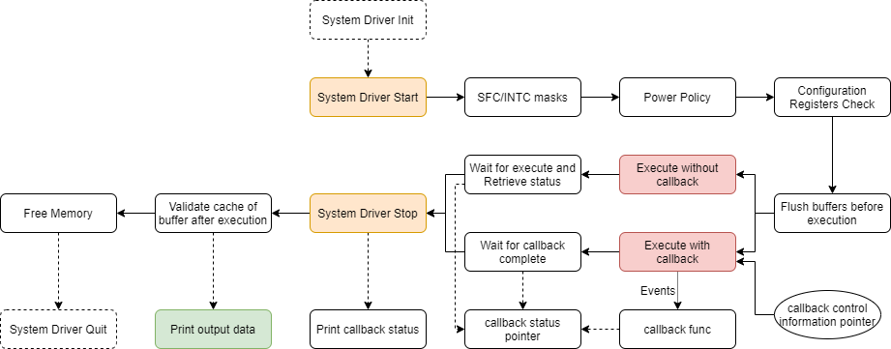
6. SW WORKFLOW
■ START / EXECUTE / STOP
Lock mutex
Enable top-level INTC group
Set DMA registers and start DMA
Disable top-level INTC group
If use callback: Set User callback function
Unlock mutex
Read two registers and check if equal to expected value
Free buffers using
R_OSAL_MmngrDealloc
Validate cache of buffer using
R_OSAL_MmngrInvalidate
Flush input/output buffers
API: R_OSAL_MmngrFlush
Spo_cb_ctl
.cb_status
.cbfunc
Driver Steps | Flow State
Init | UNINIT -> INIT
Start | INIT -> READY
Execute | READY -> EXEC -> READY
Stop | READY -> INIT
Quit | INIT -> UNINIT
.cb_dma_status
.cb_sys_status
.cb_sys_err_status[]
…
After HW raise any events, invoke the callback function

Slide 9
6. SW WORKFLOW
App SW
InitParam / changeParam / SetIn / SetOut
Config Library
Step 1. App request cfg. Object init & update
System Driver
OSAL
HW IP

Slide 10
6. SW WORKFLOW
App SW
InitParam / changeParam / SetIn / SetOut
Config Library
Step 1. App request cfg. Object init & update
Step 2. ConfLib fills in cfg (reg) value & DMA
System Driver
OSAL
HW IP

Slide 11
6. SW WORKFLOW
App SW
InitParam / changeParam / SetIn / SetOut
Config Library
Step 1. App request cfg. Object init & update
Step 2. ConfLib fills in cfg (reg) value & DMA
Step 3. Cfg final / overall consistency check
Finalize
Push cfg to HW
Trigger the HW processing
OSAL
HW IP

Slide 12
6. SW WORKFLOW
App SW
InitParam / changeParam / SetIn / SetOut
Config Library
Step 1. App request cfg. Object init & update
Step 2. ConfLib fills in cfg (reg) value & DMA
Step 3. Cfg final / overall consistency check
Step 4. push cfg to HW & trigger execution / processing
Finalize
Push cfg to HW
Trigger the HW processing
OSAL
HW IP

Slide 13
6. SW WORKFLOW
App SW
InitParam / changeParam / SetIn / SetOut
Config Library
Step 1. App request cfg. Object init & update
Step 2. ConfLib fills in cfg (reg) value & DMA
Step 3. Cfg final / overall consistency check
Step 4. push cfg to HW & trigger execution / processing
Step 5. HW processing done
Finalize
Push cfg to HW
Trigger the HW processing
Int : end processing
OSAL
HW IP

Slide 14
6. SW WORKFLOW
App SW
InitParam / changeParam / SetIn / SetOut
Config Library
Step 1. App request cfg. Object init & update
Step 2. ConfLib fills in cfg (reg) value & DMA
Step 3. Cfg final / overall consistency check
Step 4. push cfg to HW & trigger execution / processing
Step 5. HW processing done
Step 6. App get status (w/o CB)
Finalize
Poll DRV status
Push cfg to HW
Trigger the HW processing
Int : end processing
OSAL
HW IP

Slide 15
6. SW WORKFLOW
App SW
InitParam / changeParam / SetIn / SetOut
Config Library
Step 1. App request cfg. Object init & update
Step 2. ConfLib fills in cfg (reg) value & DMA
Step 3. Cfg final / overall consistency check
Step 4. push cfg to HW & trigger execution / processing
Step 5. HW processing done
Step 6. App get status (w/ CB)
Finalize
Call app CB
Push cfg to HW
Trigger the HW processing
Int : end processing
OSAL
HW IP

Slide 16
Step1: App requests cfg. object init & update
App SW
1
initParam / changeParam / setIn / seOut
img
p_IN_img
p_OUT_buf
cfg_val
out buff
cfg reg val
DMA cfg
ID

Slide 17
Step2: ConfLiB fills in cfg (reg) values & DMA
App SW
1
initParam / changeParam / setIn / seOut
2
img
p_IN_img
p_OUT_buf
cfg_val
out buff
cfg reg val
DMA cfg
ID

Slide 18
Step2a: cgf Obj final / overall consistency check
App SW
1
2
2a
finalize
img
p_IN_img
p_OUT_buf
cfg_val
out buff
cfg reg val
DMA cfg
ID

Slide 19
Step3: push cfg to HW & trigger execution/processing
App SW
1
Update
cfg obj
2
finalize
img
3
p_IN_img
p_OUT_buf
cfg_val
out buff
cfg reg val
1) push cfg to HW
2) trigger the HW processing
DMA cfg
ID
flag
3
HW IP

Slide 20
Step 4: HW processing done
App SW
1
Update
cfg obj
2
img
3
p_IN_img
p_OUT_buf
cfg_val
out buff
cfg reg val
1) push cfg to HW
2) trigger the HW processing
DMA cfg
3
4
int: end processing
HW IP

Slide 21
Step 5: App gets status (w/o CB)
App SW
1
Update
cfg obj
2
3
5
poll DRV status
img
p_IN_img
p_OUT_buf
1) push cfg to HW
2) trigger the HW processing
cfg_val
out buff
cfg reg val
DMA cfg
3
4
int: end processing
HW IP

Slide 22
Step 5: App gets status (w/ CB)
App SW
1
Update
cfg obj
2
3
5
call app CB
img
p_IN_img
p_OUT_buf
1) push cfg to HW
2) trigger the HW processing
cfg_val
out buff
cfg reg val
DMA cfg
3
4
int: end processing
HW IP

Slide 23
Step3: ConfLiB fills in cfg (reg) values & DMA
App SW
1
Update
cfg obj
2
img
3
p_IN_img
p_OUT_buf
cfg_val
out buff
cfg reg val
1) push cfg to HW
2) trigger the HW processing
DMA cfg
HW IP

Slide 24
App SW
1
request to “fill” confObj:
changeParam - setInput - finalize
2
confObj filled
write cfg.
trigger processing

Slide 25
Application
CPU
fusion
Image processing
(DOF / STV / ACF)
filter
(ISP / IMR)
Cam
Image processing
(DOF / STV / ACF)
Image processing
(DOF / STV / ACF)
VIP SW
2

Slide 26
Thank you

